Slide 1
Algoim Mimic – Scalling ML Model
Data Generation and Preprocessing Pipeline
Algoim data generation
Filtering step (only monotonic funtions)
Sorting the output.txt for node placement consistency
Scalling step (computing scalling factors for training data)
Data combination (into .pt file for ML training)

Slide 2
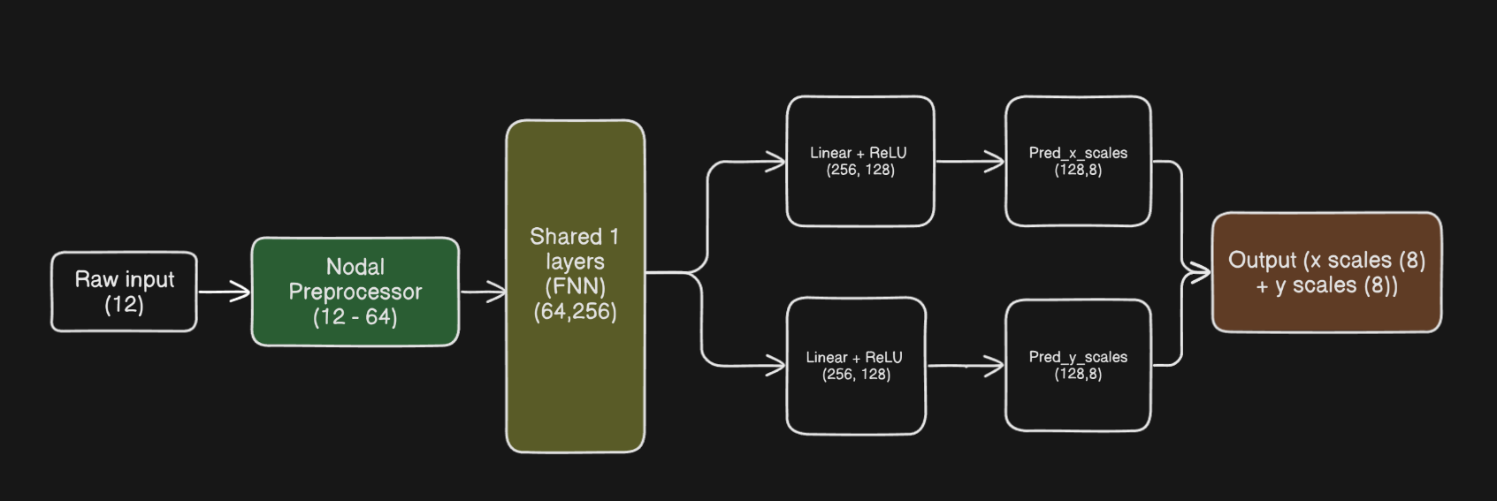
Scalling ML Model – Model

Slide 3
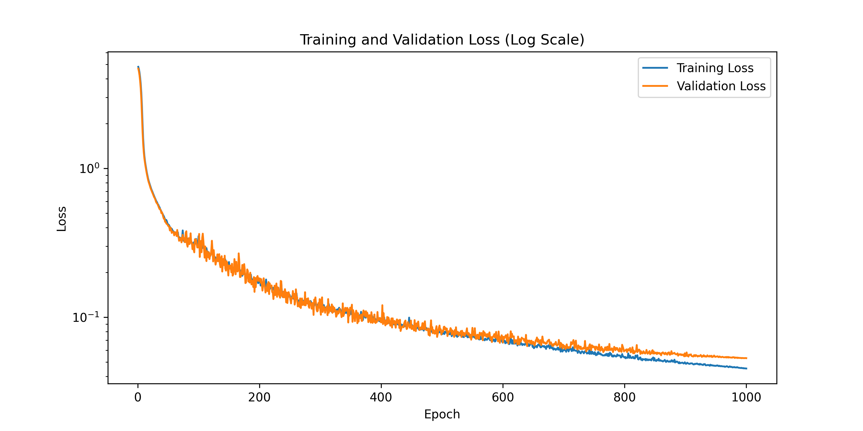
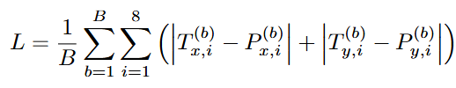
Scalling ML Model – Training
Loss function :
Parameter | Value
Batch size | 256
Optimizer | AdamW
Learning rate | 1e−3
Epochs | 1000
Precision | float64
Every 5 epochs → checkpoint
After final epoch → save model weights

Slide 4
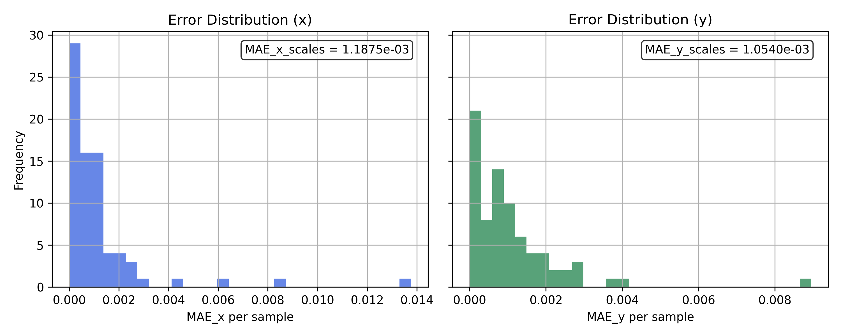
Results
MAE_x (filtered): 1.18753582e-03
MAE_y (filtered): 1.05404132e-03

